Slide 1

Officework Supplies
Your one-stop center
Go-Get project
By: Daniel Chow

Slide 2

1
What is Go-Get project?
Page 03-04
2
Get, Cleanse and Explore
Page 05-08
3
‘Two-Stage’ Model Review
Page 09-11
4
Analysis Results
Page 12-14
5
Recommendations
Page 15

Slide 3
1
What is Go-Get project?
Background
Officework Supplies tested on one telemarketing campaign recently.
Test results are extracted to understudy if there is any findings/insights that can be learnt from and leveraged on in the next similar campaign.
Our objectives are to :-
understand the characteristics of customers who responded to the campaign;
leverage on the results and enhance customer targeting using a ‘two-stage’ model (i.e. predict the likelihood to response and estimate sales values);
evaluate and maximise profit with model vs. random targeting.

Slide 4


1
High Level Approach
Methodology
Get
Cleanse
Explore
Model
Result
Acquire data
Identify & remove any invalid / duplicate records
Treat missing values using standard data imputation method
Identify strength of relationship between variables (aka features)
Manage highly correlated variables using dimension reduction technique
Drop outliers / anomalies records
Create new feature(s)
Analyse each data variable and detect any patterns/trends
Select & Transform important features for model development
Split data for model development / test
Select appropriate model(s) for development
Develop ‘two-stage’ models:-
‘first‘ propensity model to predict customer’s likelihood to response
‘second’ model to estimate customer’s transaction spend size($)
Compute expected profit from models
Rank profit from highest to lowest values and categorize them into 10 equalled sub-groups

Slide 5
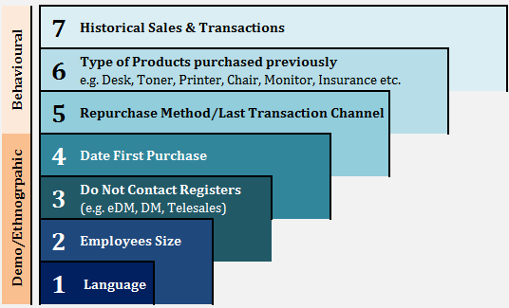
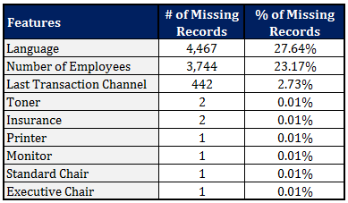
2
Get, Cleanse and Explore
A Quick Glance
What do we know about the data?
Test results consist of 16,173 customers.
There are 21 features but can be grouped into 7 broad category as below:-
Of these, 10 customers with negative campaign sales value / historical sales which probably due to refund from previous sale.
Also, 1.5K customers who explicitly do not want to be contacted via Telemarketing but were targeted. Surprisingly, 452 actually responded.
Some findings are:
invalid record / typo errors
missing values
.
Next step, data cleaning process!
Note: The term features, variables, dimensions and columns are used interchangeably herein refer to the same object.

Slide 6



2
Get, Cleanse and Explore
Step 1
Step 2
Step 3
INCREASE CLARITY
IMPROVE QUALITY
DATA INTEGRITY
3-STEPS
DETAILS
Fix data errors
Remove records with negative sales values
Impute missing data as per page 5
Assess strength of relationship between variables
Group/Combine correlated features using dimension reduction process
Remove outliers / anomalies
Design new features:
- Tenure
- Product Mix
- Contact Channel
Create standard buckets for analysis review:
- Historical Sales
- Prior Sales Trans
- Tenure

Slide 7
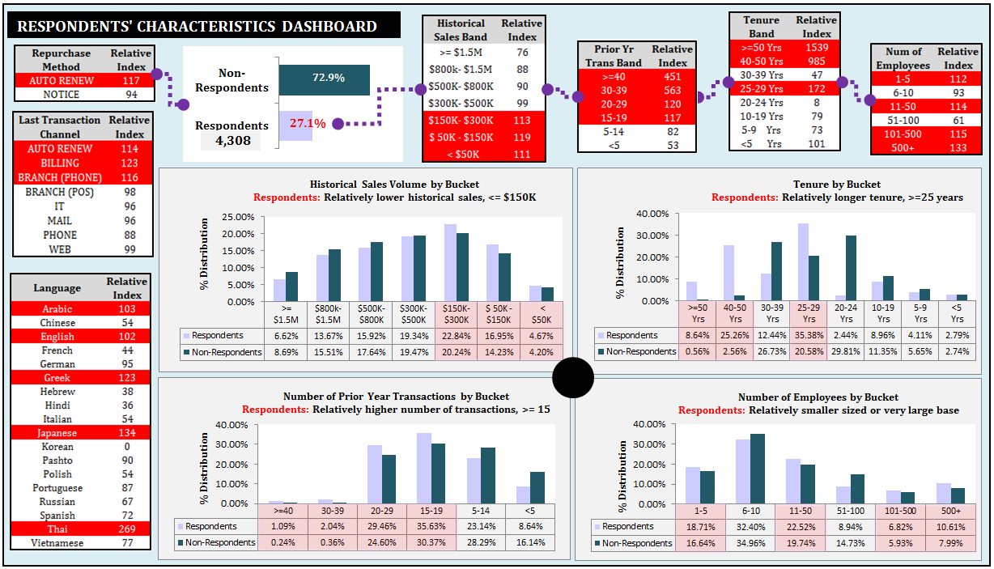
Respondents do exhibit distinct behaviors like:
- lower Historical Sales;
- higher Prior Year Transactions Volume;
- longer Tenure (aka Length of relationship);
- smaller Number of employees size or larger size;
- specific Language, other than English group.
2
Get, Cleanse and Explore
Note: Relative Index measures the strength/weakness within each features and compare between respondents and non-respondents.

Slide 8
2
Get, Cleanse and Explore
A number of features were correlated¹ to some points.
These features will distort the model outcome if untreated.
Apply dimensions reduction technique to overcome this problem.
Aspect #1 | Products purchased previously
Monitor, Computer, Printer, Standard Chair & Product Mix
Aspect #2 | Do Not Contact Register(s)
Do Not Email, Do Not Mail Solicit and Do Not Telemarket
Do Not Mail Solicit & Do Not Telemarket have more weights on first component.
Do Not Email takes 55% weights on the second component.
In summary, all these features can be combined into 1 component and each feature contributed equal weights.
Note1: Correlation measures how strongly one variable depends on another.
Note2: Scree plot is used to determine the number of factors to retain in an exploratory factor analysis (FA).

Slide 9
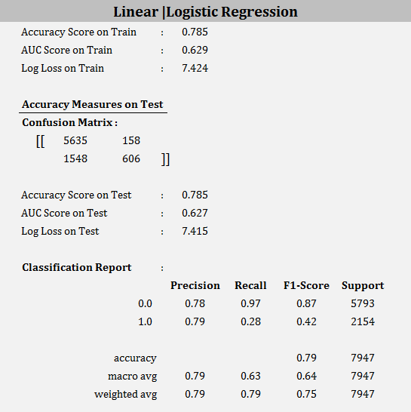

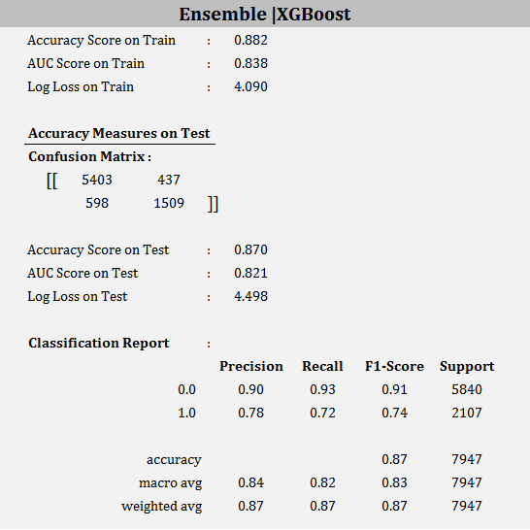
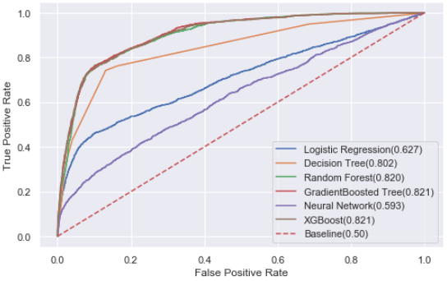
3
‘Two-Stage’ Model Review – First Propensity Model
1. Train 50%
2. Classification Model
Features selection, Parameters, Cross Validation, Best Parameters, Refine
4. Performance Measures
Dataset after cleansed
1. Test 50%
3. Evaluate
Receiver Operating Characteristics [ROC]
SCORING BOARD SUMMARY
Models | Test
 | Accuracy Score | AUC Score
Logistic Regression | 0.780 | 0.627
Random Forest | 0.868 | 0.820
XGBoost | 0.870 | 0.821
Comparison made on two scoring measures:
Accuracy - how well the model predicts the outcome correctly as a total.
AUC (aka AUROC) - how well the model distinguishes positive and negative outcomes , which can be easily visualised in the ROC diagram above . The higher the curve, the better its prediction.
A good predictive model can help to target better, therefore increases revenue and saves marketing expenses.
In this case, we focus on AUC score as it helps marketing to maximise conversion rate.

Slide 10
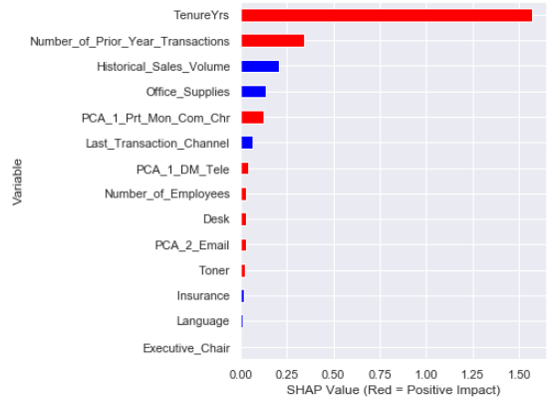
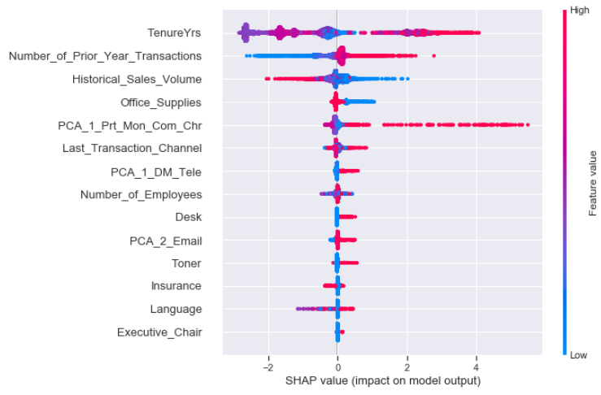
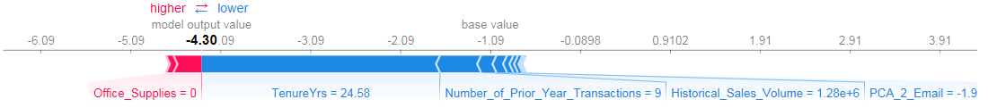
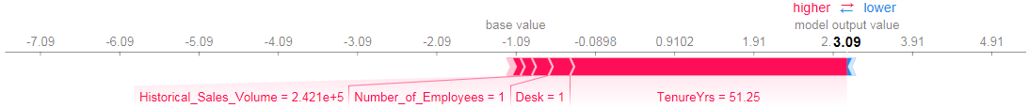
3
‘Two-Stage’ Model Review – First Propensity Model
Variables Importance Plot
The model takes the variables based on its significance and calculate the expected value. For example:
Tenure – the longer the tenure, the higher the expected value;
Number of Prior Year Transactions – the bigger prior year transactions, the higher the value;
Historical Sales Volume – the lower the historical sales, the higher the value;
Office Supplies – prior purchased of office supplies lower the value.
Illustration:
Two examples
showed how their
estimated values
are calculated.
Note: SHAP is known as SHapley Additive exPlanations. It helps to quantifies the direction of each significant variables.

Slide 11
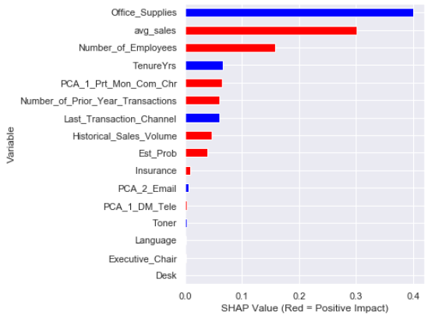
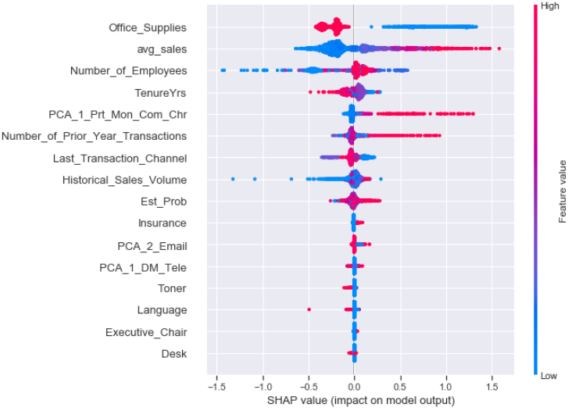
3
‘Two-Stage’ Model Review – Second Regression Model
1. Train 50%
2. Regression Model
Features selection, Parameters, Cross Validation, Best Parameters, Refine
4. Performance Measures
Respondents
Models | Test
 | R2 Score | RMSE
Ridge Regression | 0.705 | 0.563
Random Forest | 0.792 | 0.473
XGBoost | 0.813 | 0.450
1. Test 50%
3. Evaluate
Fig 1: Variable Importance Plot
Fig 2: SHAP Variable Importance Plot
Office Supplies – it plays an important factor when estimating sales spend;
Average Sales per Transaction –newly created feature – the higher the value, the lower the expected sales;
TenureYrs – the longer the tenure, the lower your expected sales.

Slide 12
4
Analysis Result – Let’s combine them!
Here are a few examples on how these models are applied:
Prediction |  | Actual
Propensity Model | Regression Model | Test Results
Probability (Sale) | Estimated (Transaction Size) | Responded | Campaign Period Sales
0.753 | $145.16 | Yes | $126.60
0.020 | $0.00 | No | $0.00
0.070 | $0.00 | No | $0.00
0.722 | $536.87 | Yes | $823.87
0.999 | $2,705.27 | Yes | $2,376.83
The two models, when combined, do project a relative strong predictive power. It combines the two model by:-
calculating the probability if the customer will respond;
and estimating the expected sales value.
Next stage, how to maximise profit with this!

Slide 13
4
Analysis Result – Expected Profit Calculation
Relevant financials components:
Gross margin on sales : 22%
Campaign cost per business contacted : $45.65
Transaction cost per transaction : $ 8.40
E(Profit) = 0.22*Prob(Sale)*Est(Transaction Size) - $8.40*Prob(Sale) - $45.65
Taking the same examples from previous slide, the expected profit is calculated as below:
Model 1 | Model 2 | Combined
Probability (Sale) | Estimated (Transaction Size) | Expected Profit $
0.753 | $145.16 | -$27.93
0.020 | $0.00 | -$45.82
0.070 | $0.00 | -$46.24
0.722 | $536.87 | $33.56
0.999 | $2,705.27 | $540.52
We can maximise the profit by leveraging on the above financial model. Let’s apply to the entire population.

Slide 14
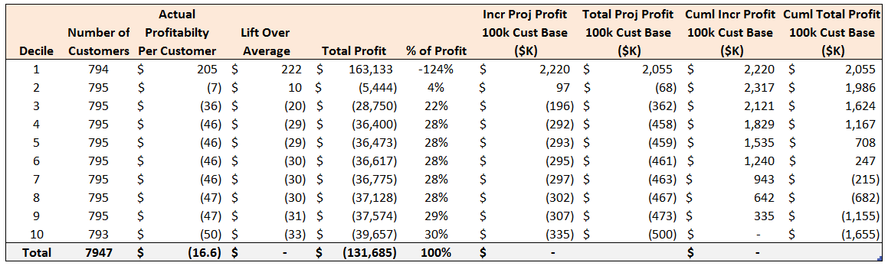
4
Analysis Result – Gain Chart
Random Targeting
Selective Targeting
Campaign went out to the entire 8K customers, company is likely to incur losses
Selecting customers based on top decile(s) can maximise company’s profit

Slide 15
5
Recommendations
Test results showed distinct characteristics between respondents and non-respondents.
1
Both models have more than 80% prediction capability in terms of calculating the probability customers will respond and estimating their expected sales values.
2
Conclusions
By adopting selective targeting on top deciles, we are able to maximise total profit or allowing business to choose the right decile(s) based on their marketing budget.
If you interested on how the models are constructed, please find details in the following link:
https://github.com/ucdcsl55/ipython
3
Propose to deploy using test-and-control groups to gauge model effectiveness and constantly improve the model through adding various touch-points like digital side of things, geo-locations or creating bespoke customer segmentation via clustering.
4

